Slide 1
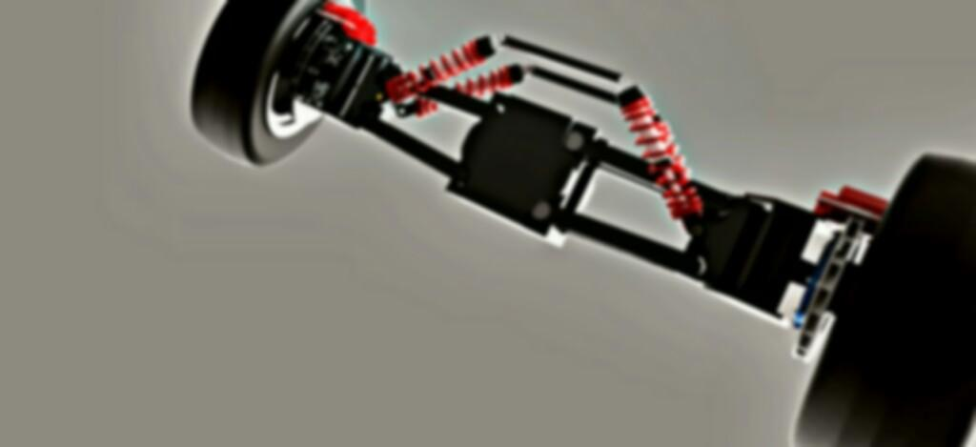


Smart India Hackathon 2020

Slide 2

Team name : Technothorn
Project name : Ultra-compact Personal Aerial Vehicle

Slide 3
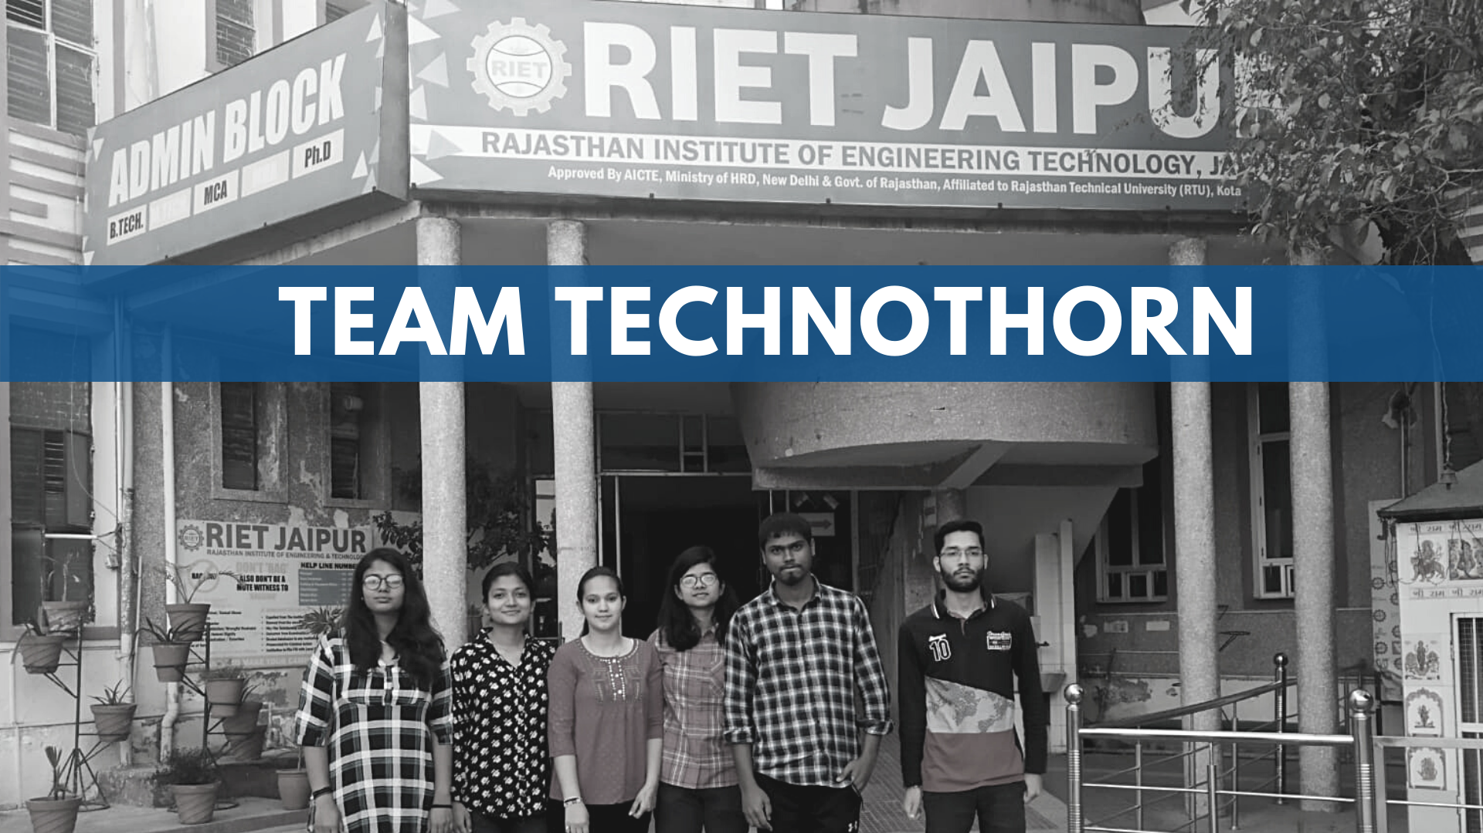

Slide 4



Slide 5
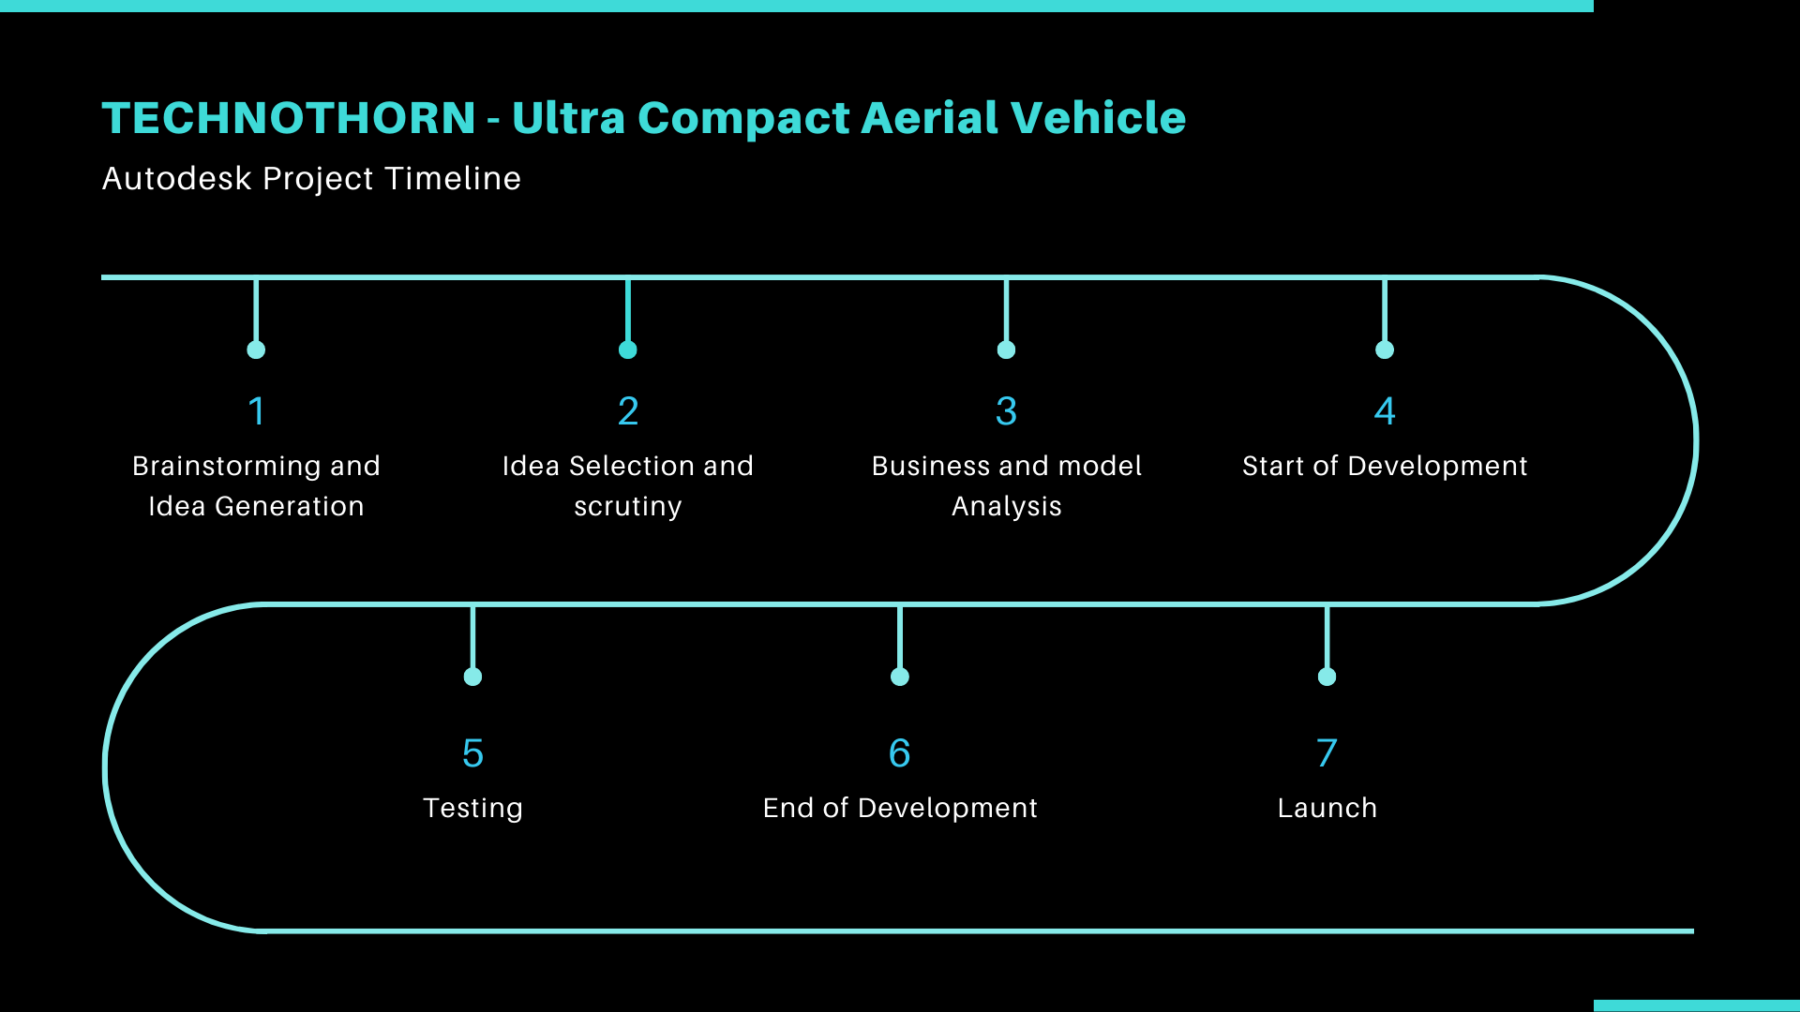
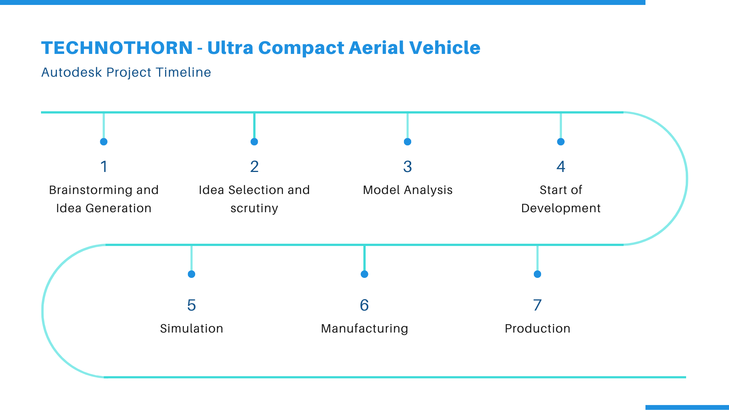

Slide 6


Slide 7
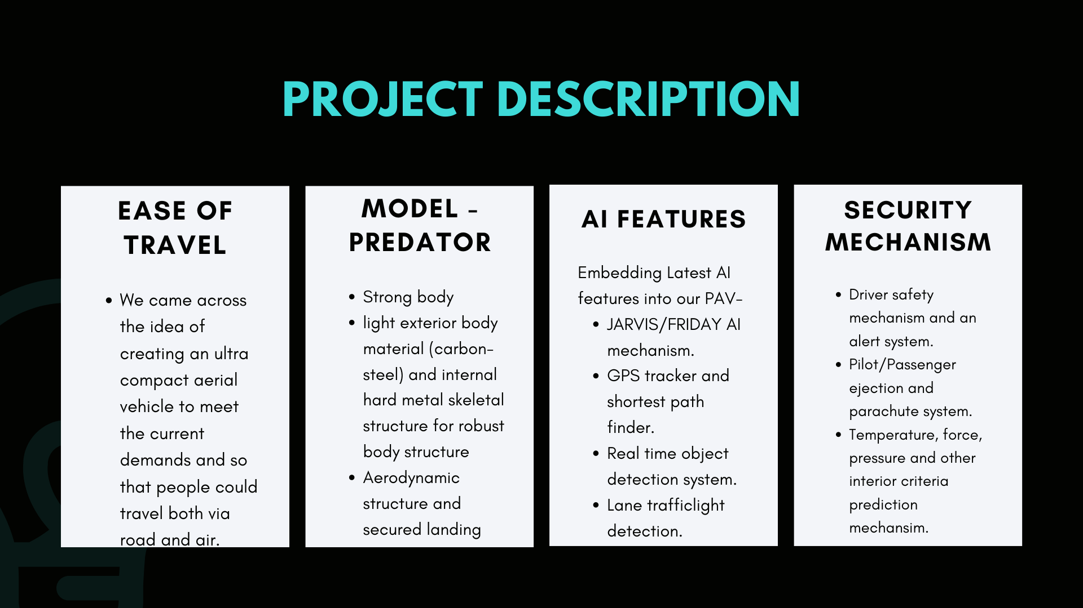
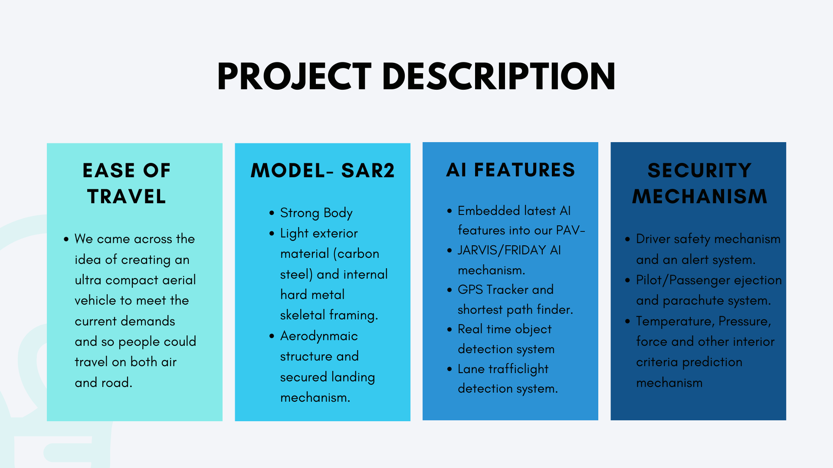


Slide 8
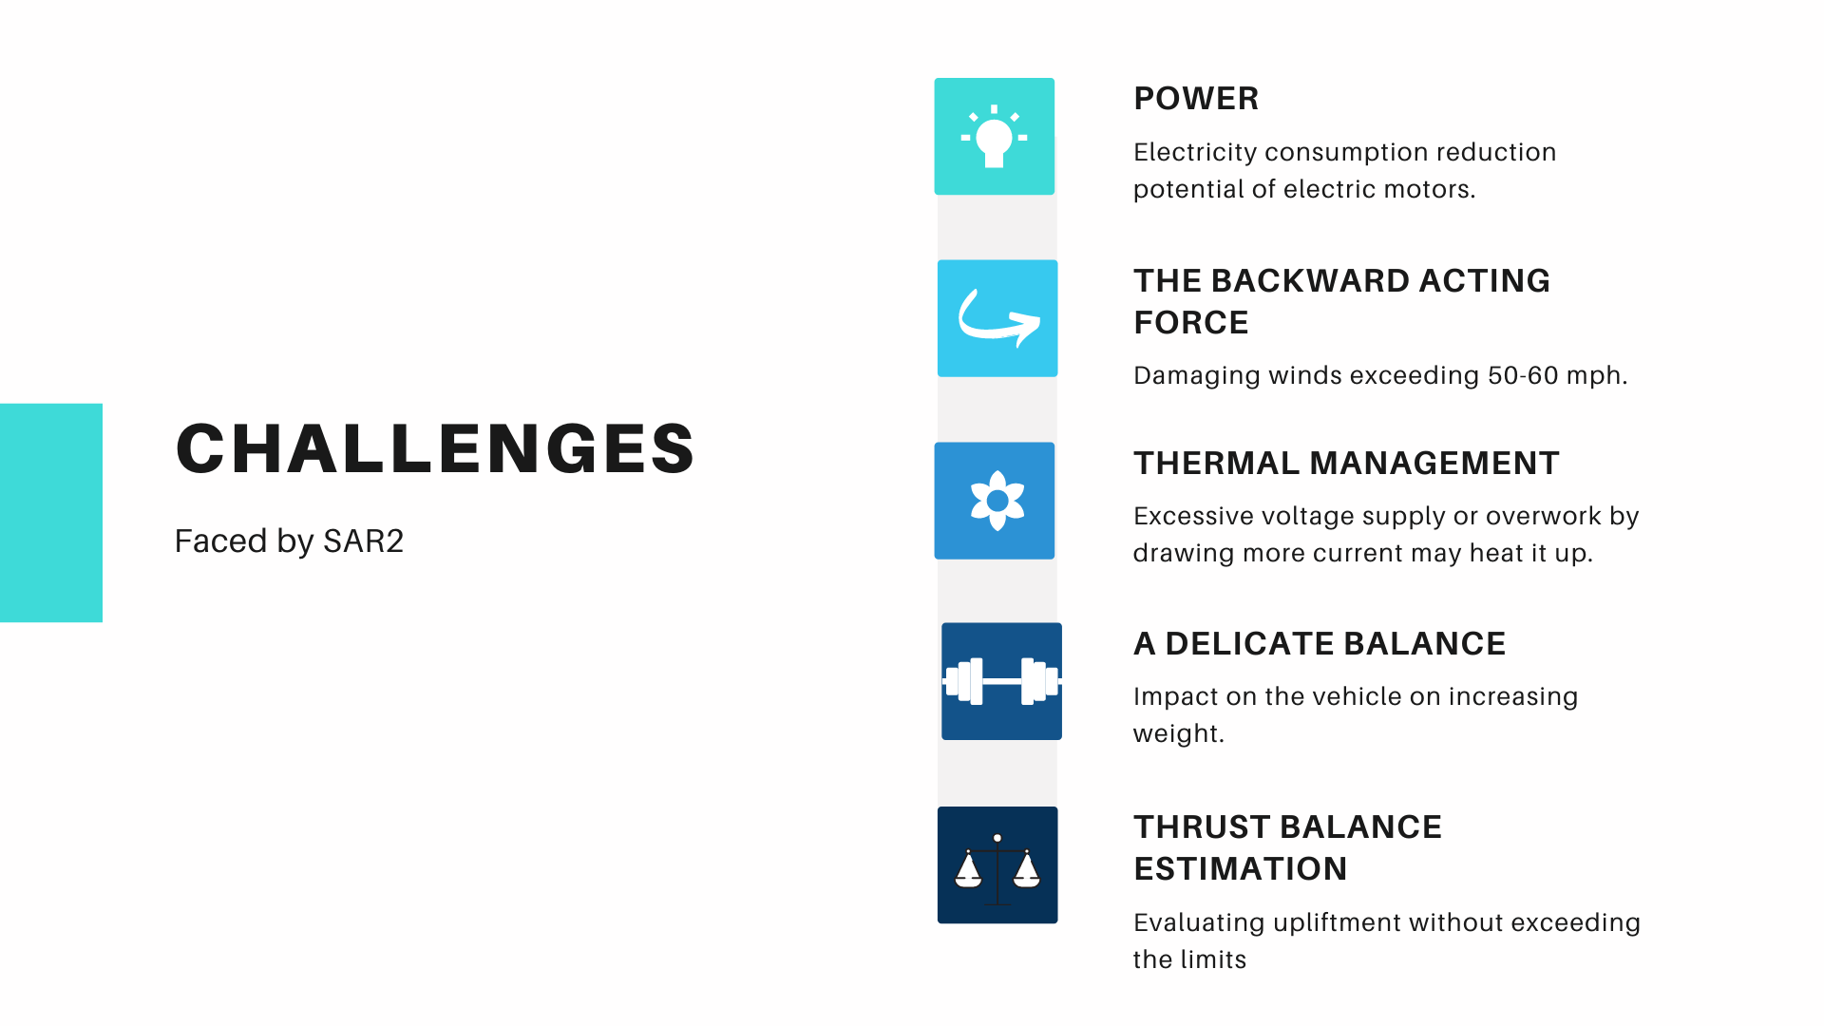

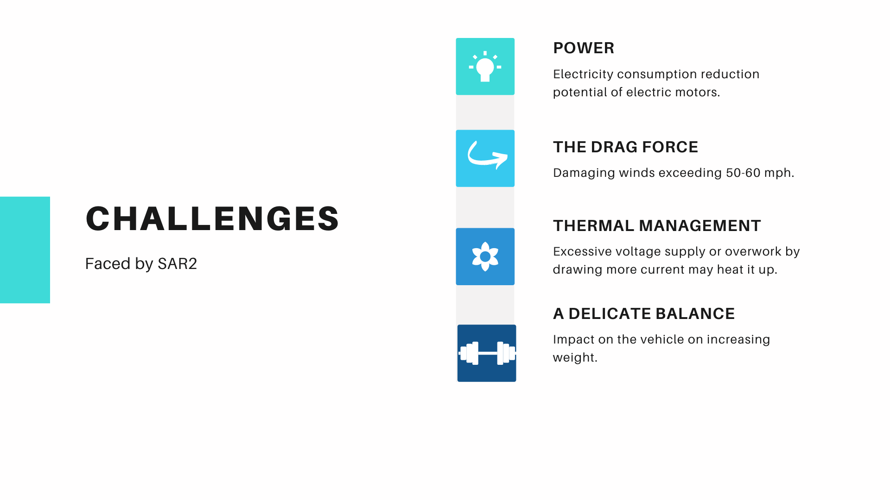
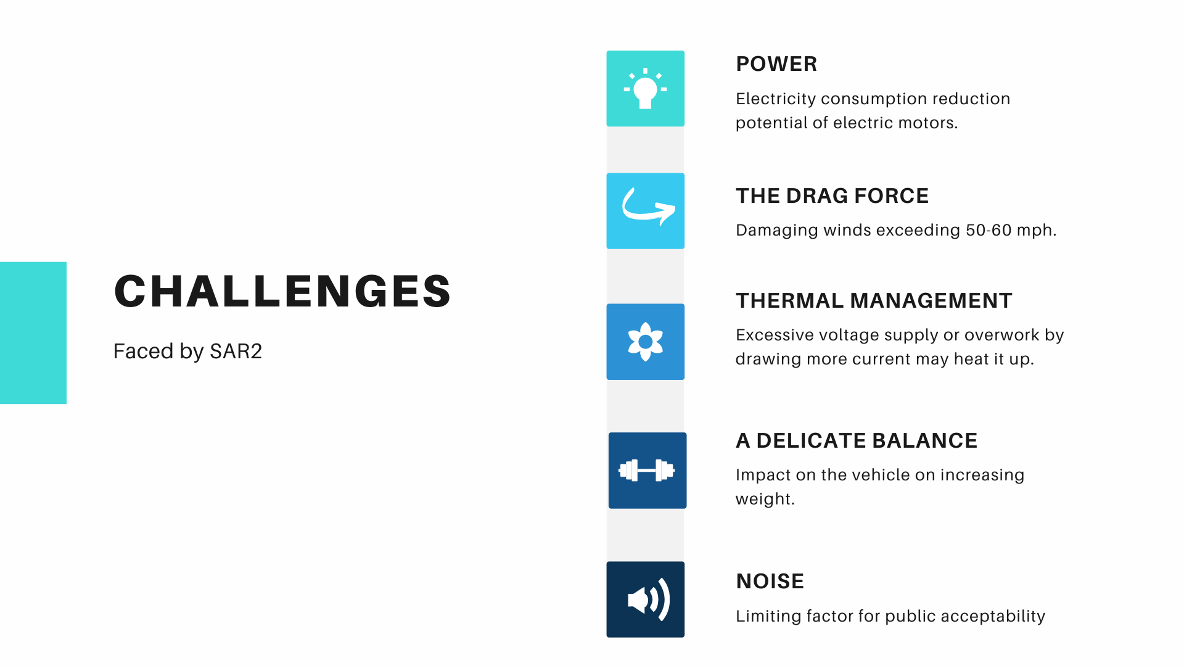

Slide 9
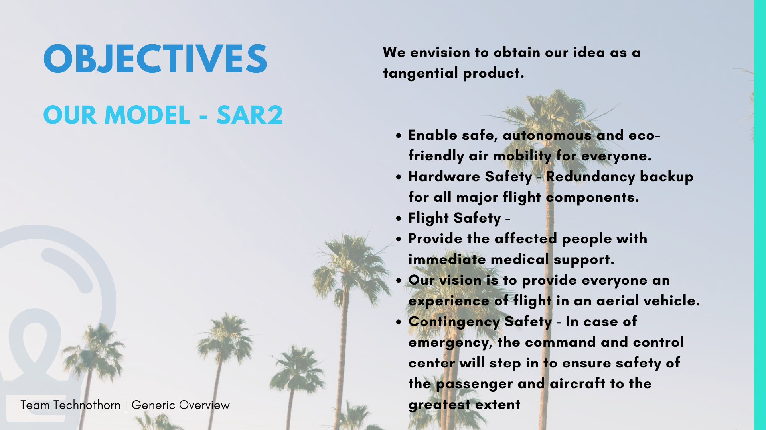
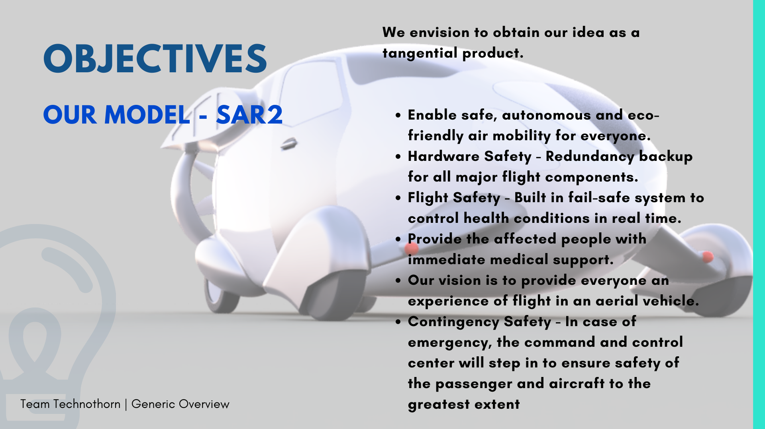
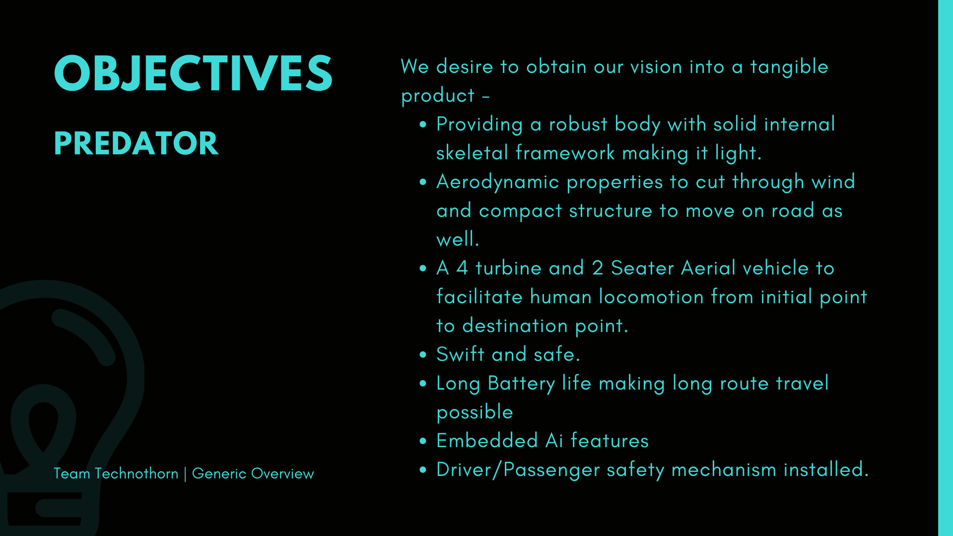
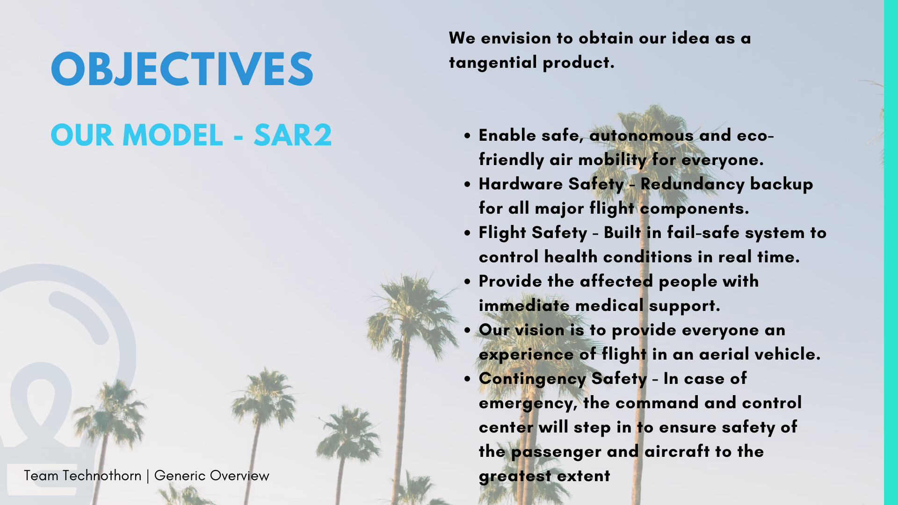


Slide 10
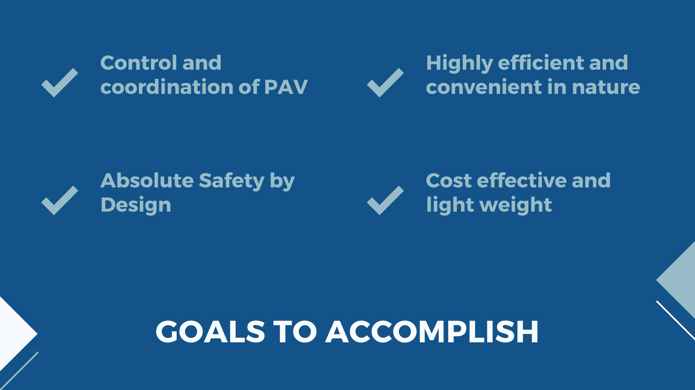

Slide 11
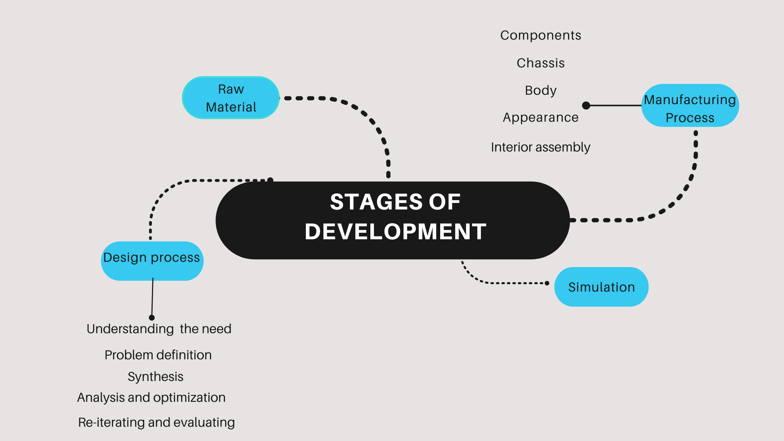

Slide 12
Key Features - SAR2
FEATURE | VALUE
Vehicle Height | 1.4 m
Vehicle width | 4.4 m
Max weight carried by PAV | 550 Kg
Total power supply | 335.256 HP
Power(drag) | 260.00 HP
Service ceiling | 3281 ft(1000 m)
Motor speed | 3000 rpm
PAV Speed | 90-100 Km/hr (approx)
Battery type | Li-po battery
Seats | Two

Slide 13
Key Features - SAR2(cont.)
Driver Safety Mechanism
Comprehensive Management by the smart command and Control Center
Radiator to regulate the heat generated inside the system
Electrically powered to reduce environmental harm caused by emission
Vertical take-off and landing(VTOL)
Team Technothorn

Slide 14
Sensors that make PAV work
ACCELEROMETERS : Used to measure acceleration force.
INERTIA MEASUREMENT UNITS : Measures and report a body’s specific force, angular rate, and sometimes orientation of the body.
TILT SENSORS : Enables the easy detection of orientation or inclination.
PARKING SENSOR : Designed to alert the driver of obstacles while parking.
ULTRASONIC SENSORS
CURRENT SENSOR
TEMPERATURE SENSOR

Slide 15


Slide 16
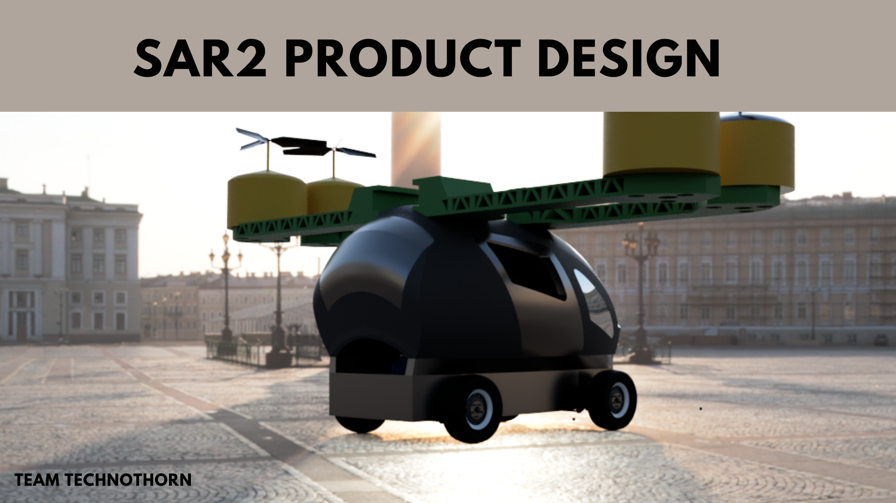

Slide 17
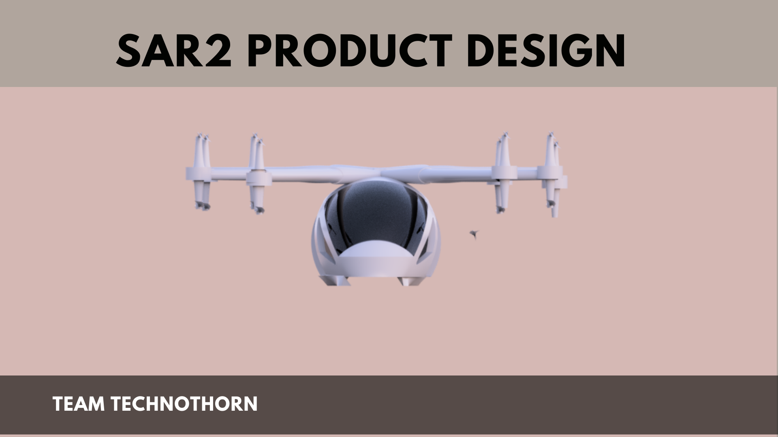
Final Product Image
# with every part description and specification
# a small rendered video if possible to be appended.
# add mission and vision
# add AI features slide.

Slide 18
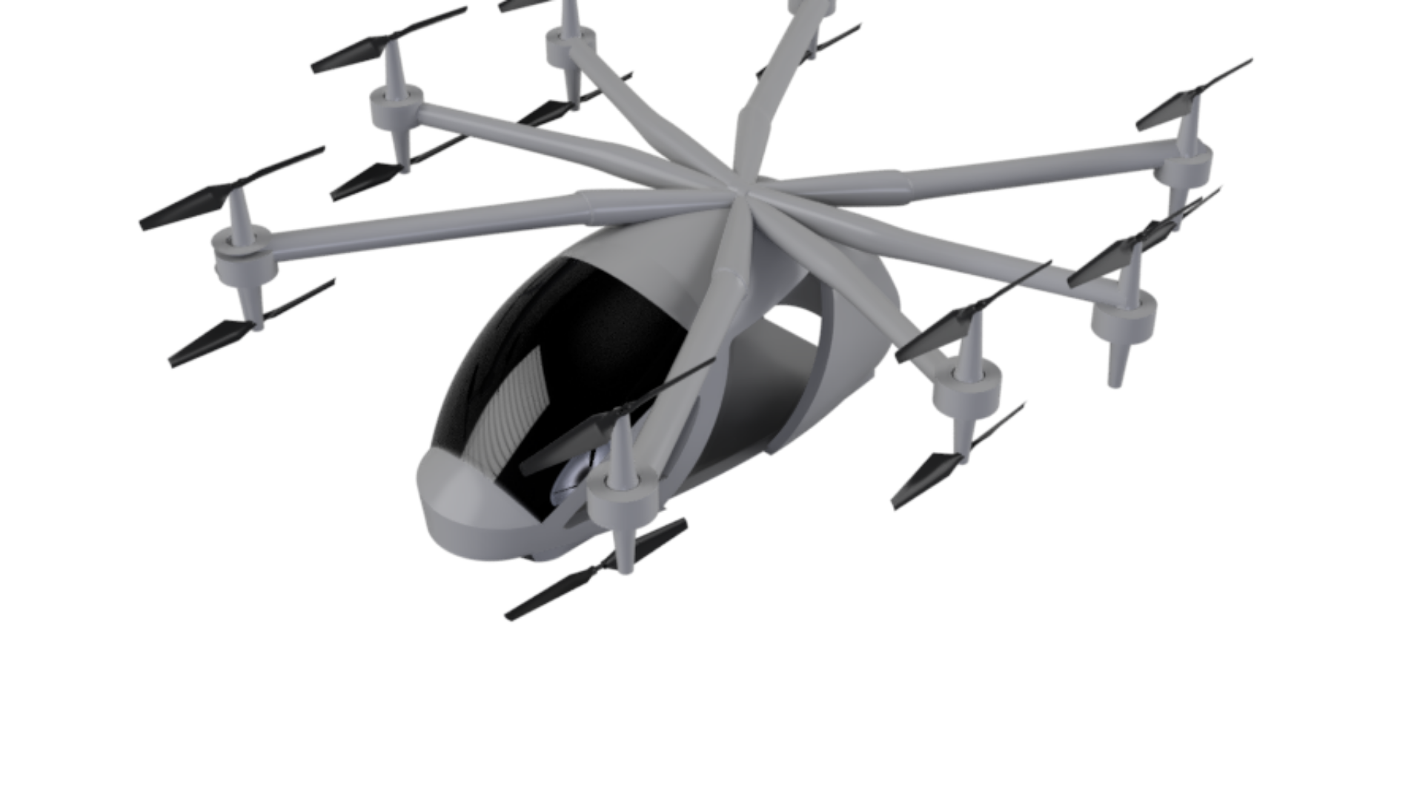

Slide 19
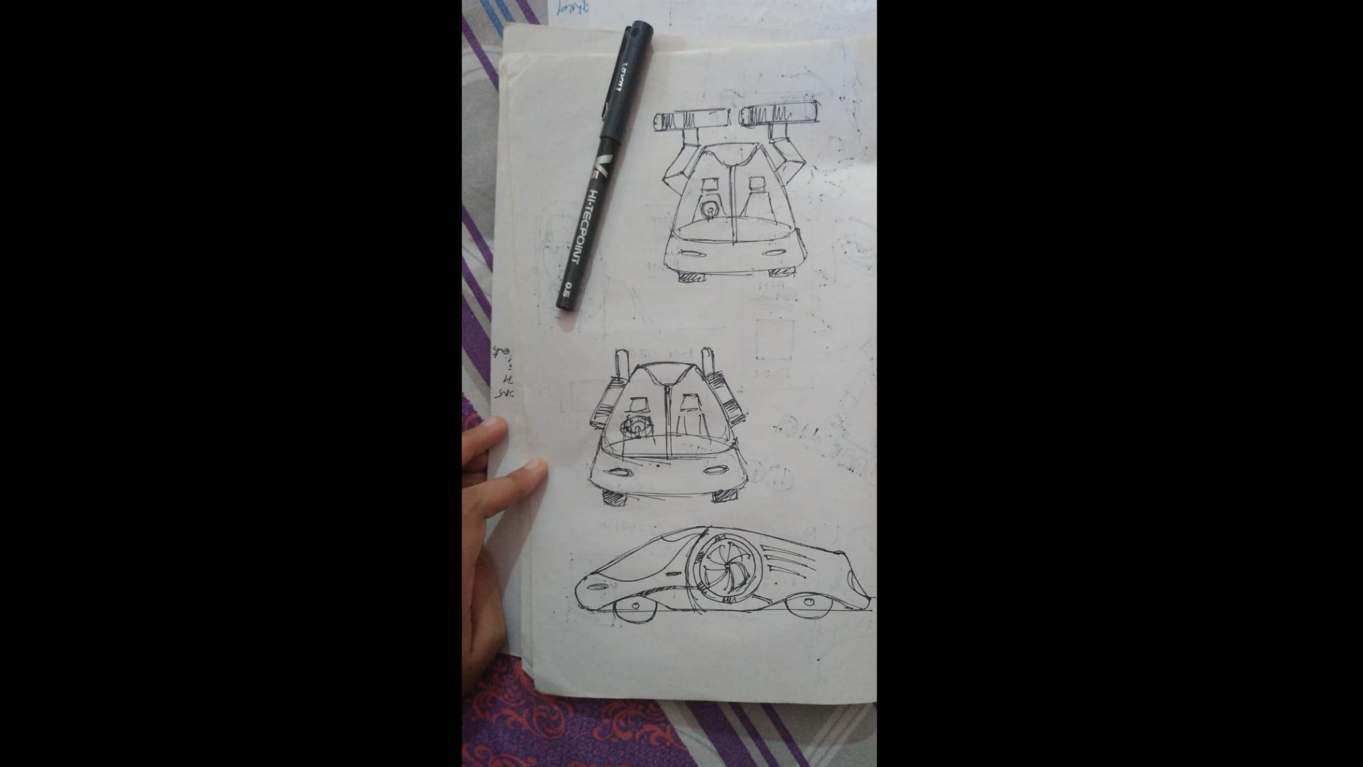

Slide 20
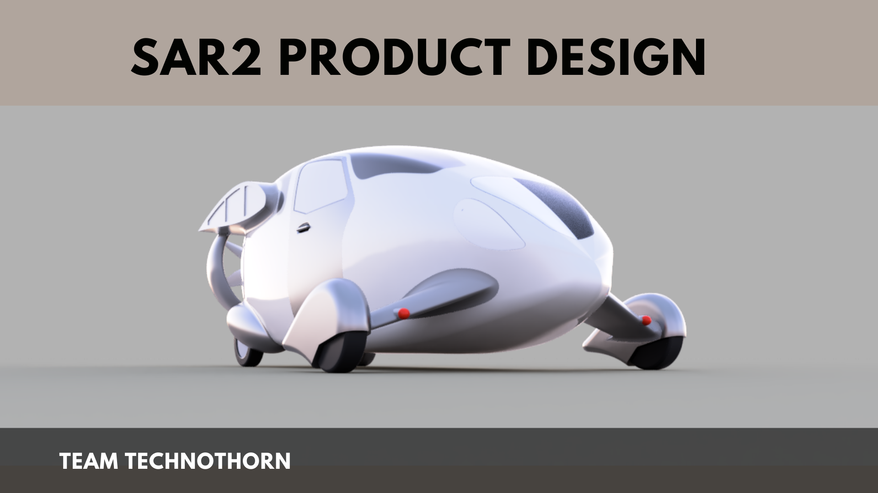

Slide 21
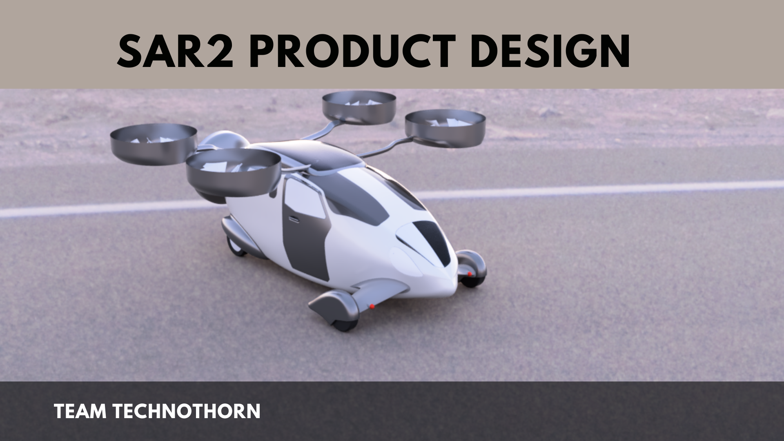

Slide 22
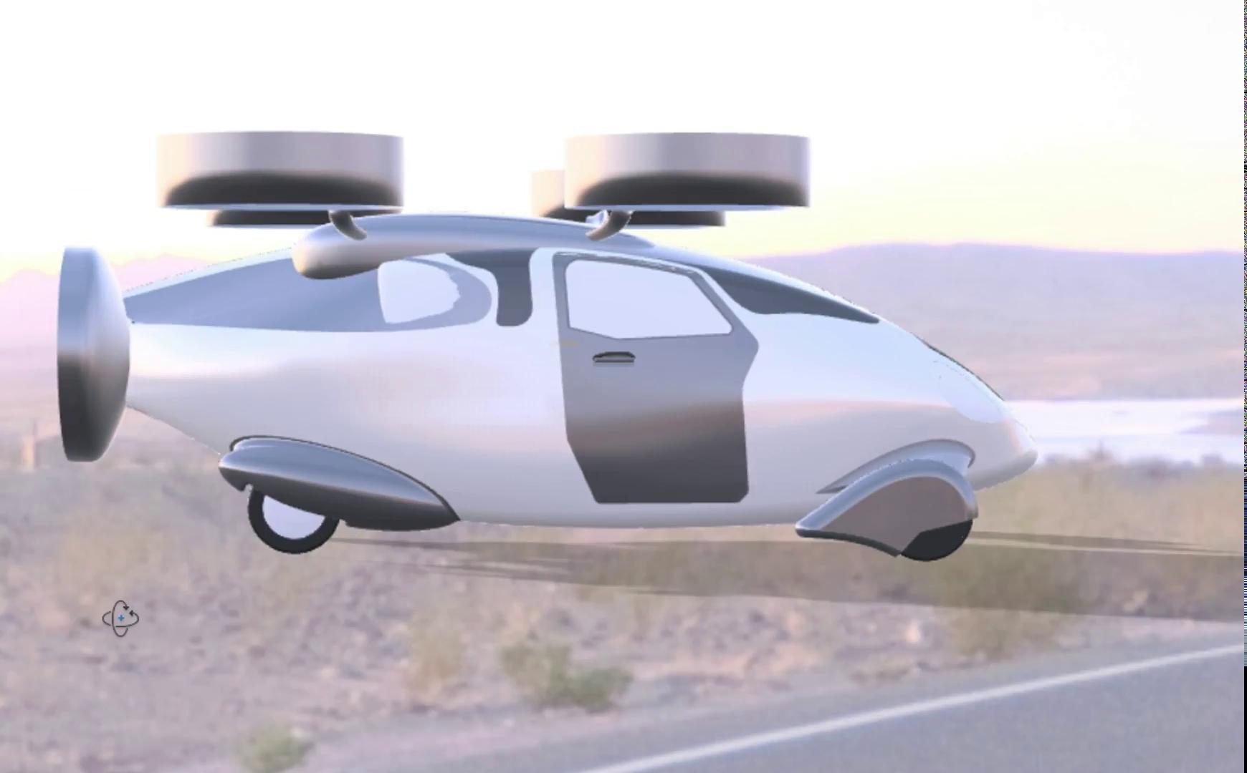

Slide 23



OPEN FOR SUGGESTIONS

